Slide 1
Conditional License Process and Supplemental Application
Presented by the Maryland Cannabis Administration and Maryland Office of Social Equity

Slide 2
Welcome and Introduction

Slide 3
MCA and OSE Staff on Webinar
Maryland Cannabis Administration (MCA)
Will Tilburg, Director
Anthony Grover, Chief, Office of Compliance and Regulation (OCR)
Lori Dodson, Senior Advisor
Lauren Boyce, Regulatory and Compliance Specialist
Andrew Garrison, Chief, Office of Policy and Government Affairs
Alison Butler, Chief, Division of Policy Implementation
Tim Dupree, Chief, Division of Stakeholder Engagement
Morgan Smith, Senior Policy Analyst
Maryland Office of Social Equity (OSE)
Audrey Johnson, Executive Director
Courtney Davis, Deputy Director
Rahsaan Peak, Senior Advisor
Anushree Goel, Economic Opportunity Officer

Slide 4
OneStop Access
How to Complete the Supplemental Application

Slide 5
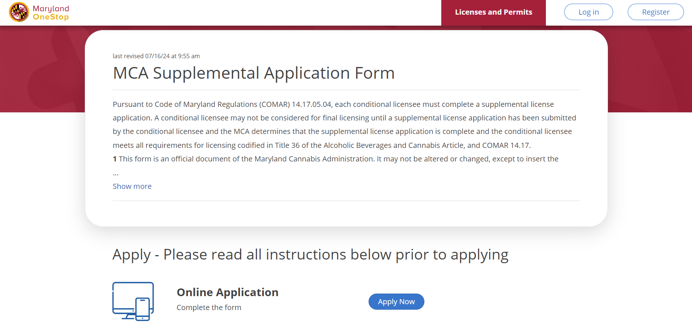
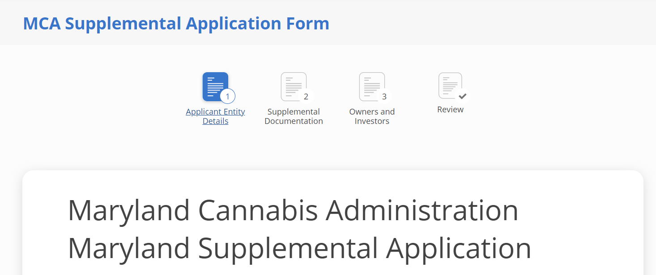
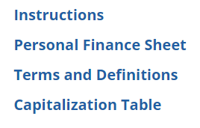
OneStop Access
Please contact lori.dodson1@maryland.gov for login assistance

Slide 6
Technical Assistance Grant

Slide 7
Technical Assistance Grant
Social Equity Conditional Licensee may receive up to $14,000 for eligible expenses including but not limited to educational programming, professional resources, and technical assistance in areas such as financial management, legal support, and regulatory compliance.
Examples include:
Business Fundamentals 101 | Business Coaching
Regulatory Compliance Support | Cultivation Education and/or Training
Business of Cannabis | Processing Education and/or Training
Good Manufacturing Practices Training | Quality Management
Financial Management Services | Business Advising and Consulting
Real Estate Services | Trade Association Memberships and Events
Legal Support Services | Banking & Lender Resources & Services

Slide 8
Grant Eligibility
To receive your grant funds, you must:
Hold a conditional license issued by the Maryland Cannabis Administration.
Opt in through the Technical Assistance Grant Submission Form.
Be in good standing with the State. OSE will verify your SDAT number.
Complete a W-9 form and submit via email to grants.ose@maryland.gov. W-9 business type must match your SDAT business type.
Ensure no taxes are owed to the State.
Complete and sign the Technical Assistance Grant Agreement.

Slide 9
Technical Assistance Vendor List
In March 2024, OSE issued a Request for Applications (RFA) to identify Service Providers that have an interest in participating in the Technical Assistance Grant Program by making their services available for Social Equity Conditional Licensees to purchase.
The vendors included on the Service Provider List are not endorsed or officially recommended by OSE or the State of Maryland.

Slide 10
Next Steps
OSE will provide the Maryland Department of Commerce with a list of eligible conditional licensees that have opted in, are in good standing with the State of Maryland, and have an accurately completed a W-9 form.
Commerce will generate and deliver the Grant Agreement for signature via Docusign. Funds will be disbursed to the address on your W-9.
Individuals that do not respond in a timely manner may forfeit their opportunity to receive grant funds.
The Grant funds cannot be disbursed without an accurately completed W-9.
Please direct any grant related questions to: grants.ose@maryland.gov

Slide 11
Social Equity Grant Partnership Program
Program Overview and Update

Slide 12
What is the Social Equity Grant Partnership Program (SEPP)
SEPP aims to address the speciﬁc needs of social equity licensees by facilitating partnerships between currently operating cannabis businesses and new businesses holding conditional licenses.
SEPP is a catalyst for change, driving forward a culture of inclusivity, collaboration, and empowerment within Maryland’s cannabis community.
By leveraging the strengths and experiences of both established and emerging businesses, we aim to build a more equitable and sustainable industry for all stakeholders involved.

Slide 13
SEPP Program Vision
OSE will administer the program and will award grants to operational cannabis licensees that have qualifying partnerships with a social equity licensee.
A “Qualifying partnership” means a meaningful partnership between an operational cannabis licensee and a social equity licensee that
Supports or advises the social equity licensee; and
Is authorized by the Administration

Slide 14
SEPP Qualiﬁed Partnerships
Qualifying partnerships include a partnership through which the operational cannabis licensee provides services at a discount for social equity licensees (typically at 50% of market value) for services including:
Training
Mentorship
Shared commercial space or equipment
Facility rental
Equipment lease or purchase
Administrative support
Biomass purchase/discount
White labeling
METRC Assistance

Slide 15
SEPP Potential Grant Amounts
Grant amounts shall be based on the nature of the qualifying partnership between the social equity licensee and the operational cannabis licensee.
$5 Million
$4 Million - Standard License
$200k
20 Grants
$1 Million - Micro License
$100k
10 Grants

Slide 16
SEPP Eligibility Requirements
Social Equity Conditional Licensees are encouraged to have the following milestones completed prior to application:
Established Management/Leadership team
Completed business plan
Provide documentation to show adequate 6-Month capitalization as deﬁned by the Maryland Cannabis Administration

Slide 17
SEPP Partnership Process
SEPP Tours
Tours will be coordinated with Operating Current Licensees (OCL) & Social Equity Licensee (SEL) based on cross interest. The tours will be open to all SEL.
SEL SEPP Eligibility Process
Business Plan & Pitch Deck
Review of OCL Engagement Form to identify synergy and select partners
Submit to OCL based on expressed partnership interest
Identify mutually interested partners to 2-3 OCL to potentially submit applications
Pairing and Partnership Development
OCLs & SELs will meet to identify mutually beneﬁcial business goals and begin developing a collaborative partnership plan that demonstrates a pathway for SEL to be operational in 18 months.

Slide 18
SEPP Partnership Process
SEPP Grant Submission Begin
SEPP Partners will submit a detailed partnership plan and application showing the viability and likelihood of the partnership to lead to operational success. Including use of grant funds.
Must be approved by OSE.
SEPP Grant Submission Closes. All Grant request will be reviewed
Pass/Fail Rubric will be used to determine approved applications
In the event there are more partnership applications than grants available, a random selection process will instituted.
SEPP Grants Awarded

Slide 19
SEPP PROJECTED TIMELINE
SEPP Tours September 2024 - November 2024
SEPP Amendment September 2024
SEPP Grant Application Release November 2024
SEPP Grant Application Close December 2024
SEPP Grant Awarded January 2025
SEPP Funds Released February 2025

Slide 20
Transferring Ownership Interest in a Conditional Licensee
Restrictions on Transfer; Process for Submitting a Transfer Request

Slide 21
How and When to Make a Request
All proposed transfers of ownership must be approved by MCA before they may take effect
Transfer Requests are submitted to MCA’s Office of Compliance and Regulation for review using the online form, a link to which is included in the Conditional License Award Letter communication
When completing the form, you’ll need to upload:
Capitalization tables for the entity before and after the proposed transfer
The document(s) that will effectuate the proposed transfer (such as an assignment, Membership Interest Purchase Agreement, etc.)
The three most recent income tax returns for the transferee (if the transfer is for 5% or more). This applies equally to individual and entity transferees.
Ownership and Control and Criminal History Attestations of the transferee (if the transfer is for 5% or more). If the transferee is an entity, only individuals owning 5% or more of the transferee are required to submit the attestations.
You’ll also need to provide contact information and a brief description of the proposed transfer in the form

Slide 22
Restrictions on Transfer
The business must be owned at least 65% by verified SEA owners
The original SEA owner(s) must maintain at least 51% ownership
No transfers, regardless of the amount, can result in SEA ownership transferring “control” of the business
No person may have a 5% or more ownership interest or control in more than:
Four dispensaries;
One grower; and
One processor
Individual transferees or individual owners of business transferees must undergo a background check and cannot take ownership if they have convictions for crimes of moral turpitude.
A proposed transfer may not be completed if the transferee has taxes in arrears
Notes:
A non exhaustive list of crimes of moral turpitude was on the application and we plan to post something further on the website in the coming weeks.

Slide 23
How long does it take? Are there fees?
Given anticipated volume during the conditional license period, this process could take up to 60 days.
When MCA receives the request, we will conduct an initial review and contact you about any missing information or additional documentation we may need in order to complete the review.
You can help the process move faster by providing us with all requested information and any additional documents you believe may be helpful at the beginning of the process.
There are no fees for requests submitted during the conditional license period.

Slide 24
Buffer Zone Map

Slide 25
Buffer Zone Map — Overview
Chapter 244 (2024) set statutory guardrails for licensee locations and allows political subdivisions, also known as counties or municipalities, to establish reasonable zoning requirements for cannabis businesses.
While the MCA’s only zoning requirement is that the business complies with local zoning, the following is an example of rules set in statute:
Dispensaries are prohibited from:
Locating within 500 feet of a primary or secondary school, or childcare center; playgrounds, recreational facilities, libraries, public parks, or places of worship; and
Locating within 1,000 feet of another dispensary.

Slide 26
Buffer Zone Map — Local Zoning Authority
Based on the provisions outlined in Chapter 244, the MCA made an educational tool to help you envision what may be permissible, but ultimate permissibility of a site and approval is determined by the local planning and zoning authority. Local planning and zoning authorities may also make changes to the buffer zone requirements in State law, such as:
A political subdivision may:
By ordinance, establish a distance limitation for dispensaries of up to 100 feet from an area zoned for residential use; or
Apply to dispensaries the distance limitation for licensed alcoholic beverage retailers from an area zoned for residential use.

Slide 27
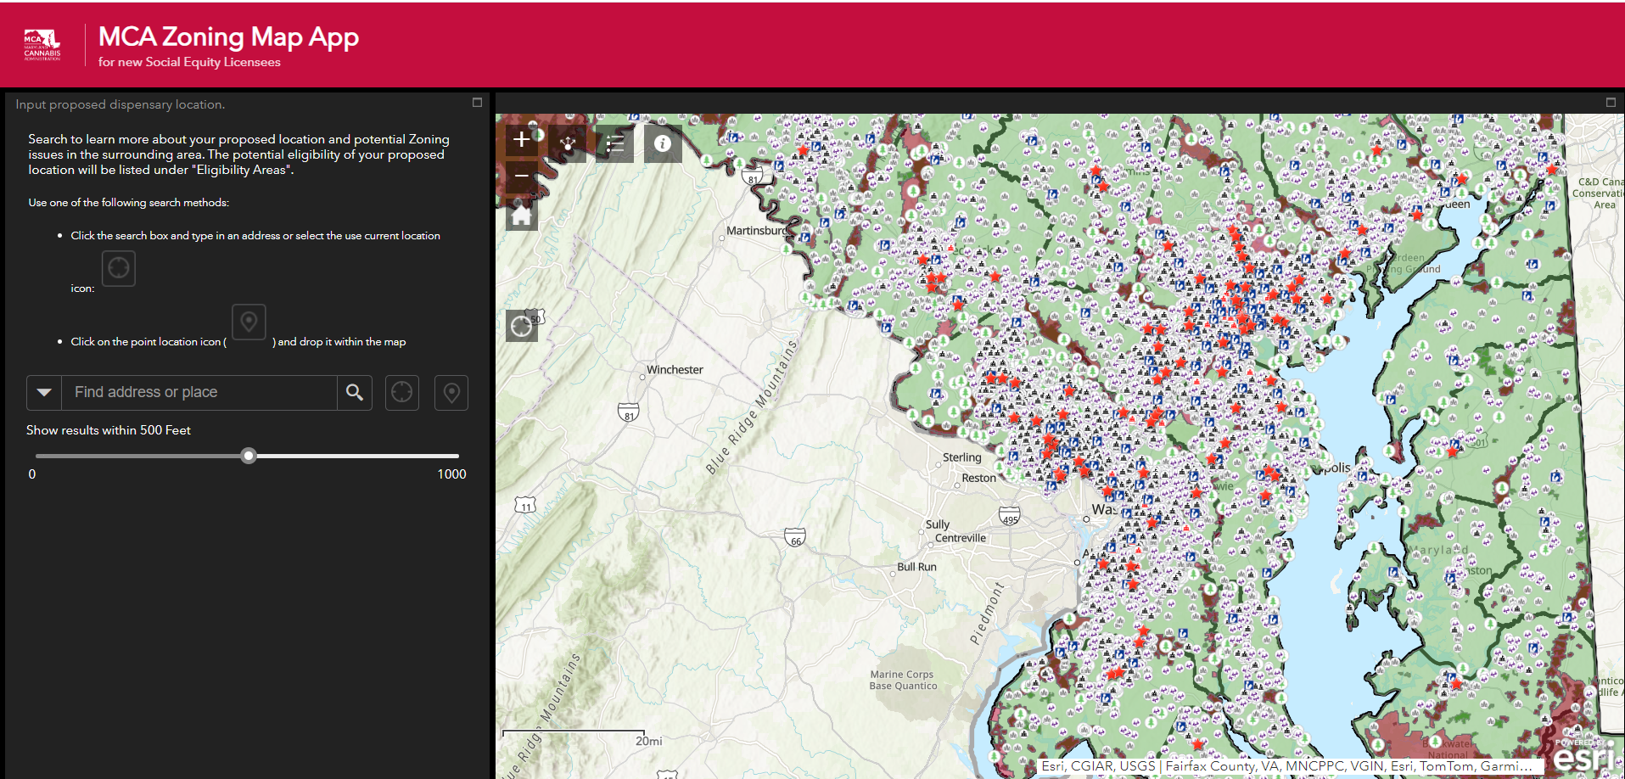
Notes:
When you open the MCA Zoning Map Application, this is the initial screen. The map looks chaotic, but it has several important components: the red stars are current locations of licensees; there are blue library markers; as well as markers indicating schools, areas of worship, public parks, and child care centers, among other things. On the left, there are two types of search features available. You can enter an address or place into the search box or you can place a pin on the map where you’d like to investigate. I’ll get into this in a minute, but there is also a slider you can adjust to change the radius around your proposed address.

Slide 28
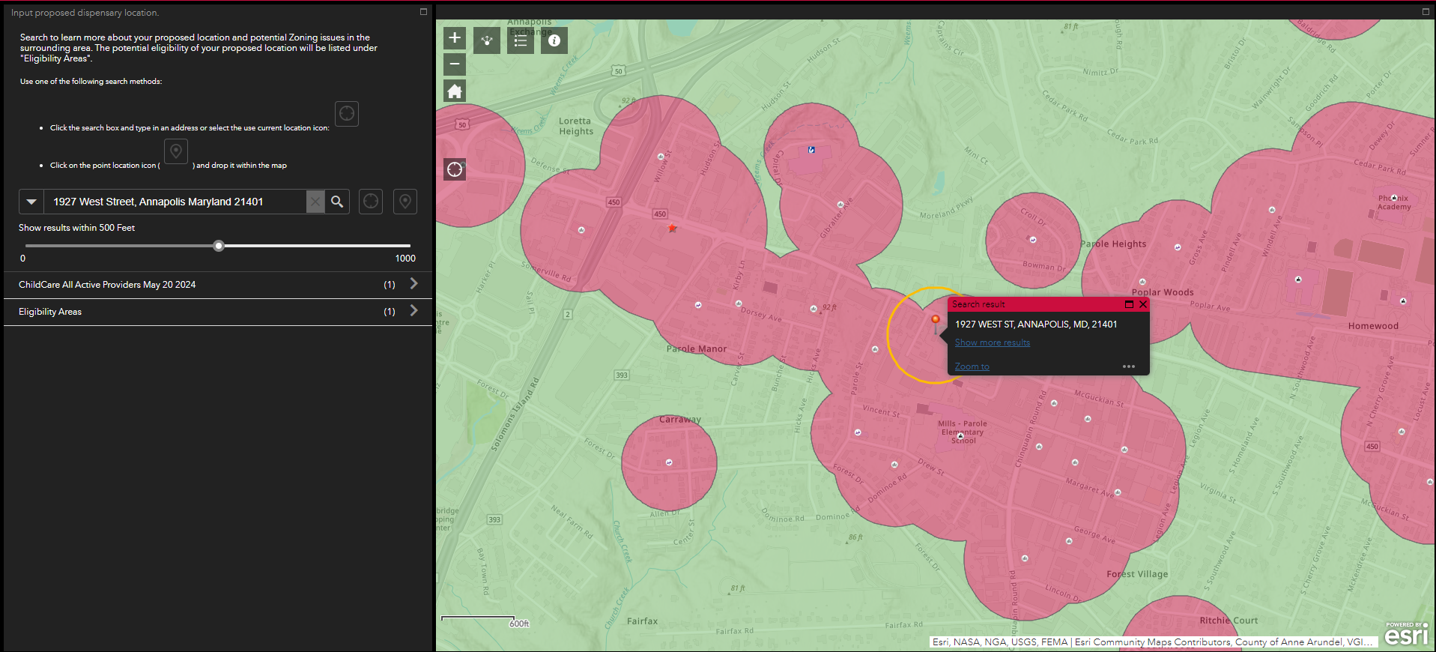
Notes:
Being from Annapolis, I decided to use the city as an example to highlight a proposed location that may not be authorized due to statutory restrictions. Of course, this is all dependent on the local zoning authority. Entering 1927 West Street, you’ll see the the pin is in red. The red clouds show entities — schools, child care centers, libraries, other dispensaries, etc — and their own protected radius potentially preventing the establishment of a new licensed entity. The yellow circle shows what is within 500 feet of the pinned location. You can change the circumference of that pin by utilizing the slider to the left.

Slide 29
Notes:
In this slide, you can see that I changed moved the slider from a radius of 500 feet to a radius of 1,000 feet. This is evident by the widening of the yellow circle around my pin. When I changed the radius, it added a place of worship to the list of potential locating conflicts. As this is an educational tool, it only captures the publicly available data regarding the locations of entities of conflict. Some of these could not exist any longer and there could also be new entities that aren’t captured by this map. Your local zoning authority will know best about what is or isn’t a viable location for your business.

Slide 30
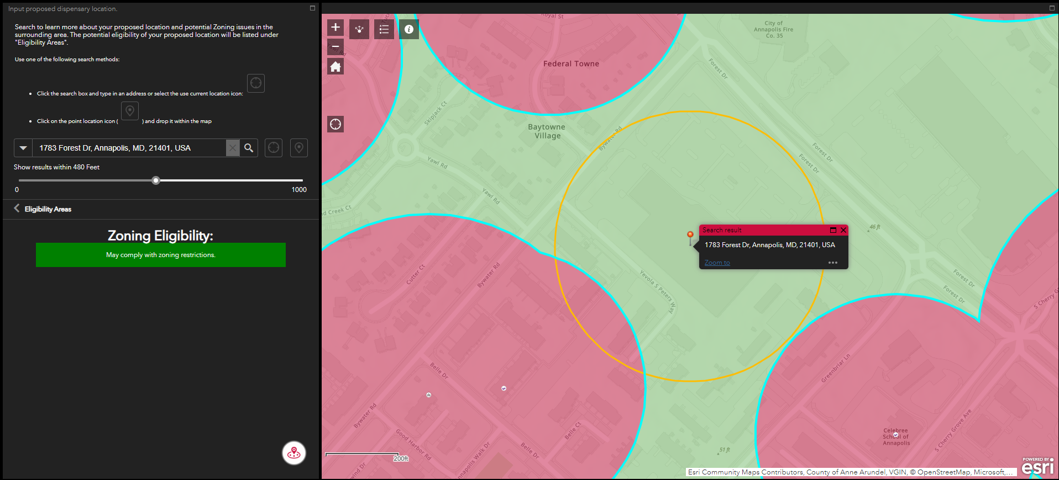
Notes:
This is an example of a location that might comply with local zoning restrictions, pending a decision by local zoning authorities. One parallel street over from the previous slides, there is a shopping center on Forest Drive as shown on the map. If, for instance, you entered a location that was promising, you would get a notice in green like the one to the left indicating that it might be a good location to pursue. Again, this is just an educational tool to show you locations of current entities that might restrict your ability to pick a potential space for your cannabis business.

Slide 31
Adequate Capitalization

Slide 32
Adequate Capitalization Requirements
Within six months of obtaining a conditional license, a selected Applicant must demonstrate it has access to capital sufficient to carry out the activities required by this license category and type.
All applicants must demonstrate adequate capitalization as part of their supplemental application on Maryland OneStop. Please upload documentation of sources of capitalization in this application.
Any source of capital must be in the name of the applicant entity or an owner/investor of the applicant entity.

Slide 33
Adequate Capitalization Requirements - Examples
Examples of documentation of capitalization include the following:
(1) An independent financial statement;
(2) Credit history;
(3) Lines of credit;
(4) Promissory notes;
(5) Deeds, appraisals, and equity in real estate;
(6) Stocks and other investment holdings; and
(7) Bank statements.
The fair market value of durable equipment that the conditional licensee will use for the operation of the license may also be considered for adequate capitalization; the conditional licensee may be asked to demonstrate how such durable equipment will be used for operation of the license, and the equipment’s fair market value.
Notes:
Ex. Car

Slide 34
Adequate Capitalization Requirements - Thresholds
Class | Type | Amount of Adequate Capitalization
Micro | Dispensary | $25,000
Standard | Dispensary | $125,000
Micro | Grower | $100,000
Standard | Grower | $500,000
Micro | Processor | $35,000
Standard | Processor | $175,000
Notes:
For presentation, I would like for there to be context for these figures. These figures are not the amount needed to operate a business in these categories, as the licensees are all aware. But, this amount must be shown by 6 months to demonstrate the conditional licensee is on the way to raising capital and making progress toward licensure.

Slide 35
Management Agreement Requirements

Slide 36
Manage Agreement Guidelines – COMAR 14.17.06.05
A management company is an entity that provides management services to a licensed entity
A management company must be MCA-approved & in good standing with SDAT
A licensee must provide a copy of a management agreement to MCA and include:
Information detailing any compensation paid in exchange for the management services;
Criminal history record and financial information of the third party providing the management services; and
Any other information relevant to the management agreement requested by MCA.
A management agreement may not take effect without the MCA’s approval
The licensee must receive MCA approval before implementing any material changes to the management agreement
A management agreement may not require a licensee to:
Operate the business under a marketing plan or system that is associated with the trademark, service mark, trade name, logotype, advertising, or other commercial symbol that designates the licensee as same or similar to the management company;
Offer, sell, or distribute cannabis or cannabis products under a marketing plan or system prescribed in substantial part by the management company;
Limit the offerings of cannabis or cannabis products to another licensed entity holding a direct or indirect financial relationship to the management company; or
Sell or transfer ownership interest in the license at a later date to the management company.

Slide 37
Management Agreement Guidelines: COMAR 14.17.06.05E&H – Grounds for Denial
The MCA may deny a management agreement:
If it constitutes an invalid transfer of an ownership interest in a license, as specified in COMAR 14.17.06.04;
If the criminal history record information or the background investigation reveals the personnel of a third party providing the management services has been convicted of or pleaded nolo contendere to a crime involving moral turpitude
If the management agreement transfers control of a license in violation of Alcoholic Beverages and Cannabis Article, §36-503, Annotated Code of Maryland or if it conveys to a management company:
Unilateral control as defined in COMAR 14.17.01; or
The right or authority to make major marketing, production, and financial decisions, including:
The right or authority to operate the business under a trademark, service mark, trade name, logotype, or other commercial symbol that is the same as the management company or another licensee;
The right or authority to purchase a controlling interest in, or control of, the license at a later date; or
The right to or actual payment from the licensee over the course of a calendar year exceeding the greatest of:
25 percent of the licensee’s gross revenue;
50 percent of the licensee’s net profits; or
$250,000.
If the licensee fails to produce, in a timely manner, additional documentation requested by the Administration;
If the management agreement is found to be in violation of COMAR 14.17.06.05G (detailed on previous slide);
For any other good cause.

Slide 38
Access to Capital
Permissible ways to raise capital for a cannabis license

Slide 39
Access to Capital: Collaboration with Another Business
A conditional licensee may enter into branding or licensing agreements with other cannabis companies, provided the agreements comply with Maryland law. Specifically, a licensee may not enter in an agreement that permits a licensor to exercise ownership or control over the licensee’s operation. ‘Control,’ as defined in statute and regulation, includes the ability to make major marketing decisions.
Use of a Trade Name: A licensee may not operate its business using the name of another company, but it may use a name that indicates a relationship with another company. Example: There is a licensed entity called Joe’s Cannabis Shop and another licensee, Licensee A. Licensee A may not operate as Joe’s Cannabis Shop even if Joe’s would license the use of its name. However, Licensee A could operate as “Licensee A: A Dispensary that Collaborates with Joe’s Cannabis Shop”.
Licensing Agreement – A licensee may enter into a licensing agreement with another cannabis company to sell certain products. The licensor may establish requirements for how the trade name or trademark is used, including to protect its value or avoid incurring liability to the licensor. Example: A licensed company called GreenMonster could enter into a licensing agreement with another licensee to sell products bearing the GreenMonster tradename or trademark and use the GreenMonster trade name or trademark on displays in the licensee’s store or website. The agreement may require that GreenMonster products are displayed a certain way.

Slide 40
Access to Capital: Equity in the Cannabis Licensee
Under Maryland law, MCA is authorized to approve certain ownership changes during the conditional licensing period for the purpose of raising capital
Individuals verified as social equity applicants (SEA) must continue to hold at least 65% of the equity in the business
The individual(s) identified as SEA on the initial application submitted to MCA must maintain at least 51% equity in the business
Any new owner must complete the required criminal history and financial background investigation
Examples
If the initial application lists one SEA-verified individual as holding 65% of the equity in the business → can sell up to 14% equity in the entity to another SEA-verified individual
If the initial application lists one SEA-verified individual holding 100% equity in the business, they must maintain at least 51% in the entity; no more than 35% equity may be held by individuals who are not SEA-verified
If the initial application lists two SEA-verified individuals who are each 50% owners, they must collectively retain 51% or greater ownership

Slide 41
Access to Capital: Priority Return of Capital Investment
A conditional licensee may offer priority repayment to an investor, provided that once the initial investment has been repaid, the business’ payment structure returns to a proportionate amount that is consistent with its ownership structure.
Examples:
An entity is owned by 2 individuals and requires $1 million to commence operations: Owner A is the SEA and owns 65%. Owner B is a non-SEA who owns 35%. Owner A provides $250,000 and Owner B provides $750,000. Owner B may receive up to 75% of the business’ profits until Owner B’s initial investment is repaid.
An entity is owned entirely by 1 individual and requires $1 million to commence operations: The individual provides $300,000 of the initial capital and obtains the other $700,000 from a lender. The lender may receive up to 70% of the business’ profits until the initial loan is repaid.
In both scenarios, once the initial investment is repaid, payments must be distributed according to an individual’s ownership share of the entity.

Slide 42
Access to Capital: License as Collateral for a Loan
A conditional license may use the value of a cannabis license as collateral to obtain a loan from an MCA-registered creditor.
The license can be sold to an eligible bidder to satisfy the debt if the licensee becomes insolvent or otherwise defaults on its loan obligations.
The creditor must select, or a court may appoint, a receiver to oversee the orderly transfer of the license & manage the business while it is in the receivership.
A prospective receiver must apply for and receive MCA approval to act as a receiver.

Slide 43
Access to Capital: Co-Location
A conditional licensee may enter an agreement to share a space with another conditional licensee or they may lease/rent space from an operational licensee, provided certain requirements are met. These include but are not limited to:
Each licensee must store and keep separate all of its cannabis plants or products – products cannot be commingled at any stage.
Each licensee must have control over access to its storage area.
Security footage must be able to be accessed by each licensee and recorded and saved separately.
Co-located licensees may share equipment, provided the equipment is used by each licensee at separate times in a way that prevents cannabis plants or products commingling.
Co-location may not be used to circumvent ownership or control restrictions.

Slide 44
Conditional Licensees Slack Channel
Communication Platform and Learning Management System

Slide 45
BUILDING COMMUNITY THROUGH SLACK
OSE believes that building community is essential for the success of the social equity licensees. As a result, we have decided to provide social equity licensees with access to Slack to allow for the sharing of information.
Goals:
Community Building and Organizing
Platform of trusted information
Event Calendar
OSE and MCA Updates
Educational and Training Resources
Onboarding:
Expect an email with onboarding instructions no later than Friday September 6, 2024.
Training & Education will be provided.

Slide 46
FAQs
Questions submitted by Conditional Licensees

Slide 47
FAQ’s - All Licenses
Will we be able to review this webinar afterwards?
Yes! This webinar will be recorded and accessible after the fact for current and future conditional licensees.
What remaining fees are due by conditional licensees?
No further fees are due to the MCA until time of operational licensure. The fees paid at the time of final licensure are valid for 5 years. Fees will be able to be paid through Maryland OneStop
At what point can we add additional investors or transfer ownership shares?
Once the conditional license has been issued, individuals may be added to the entity, subject to statutory and regulatory restrictions, by completing a request to transfer ownership interest in a conditional license form, which is available on MCA’s website.

Slide 48
FAQ’s - Zoning
My local jurisdiction doesn’t seem to have updated cannabis zoning provisions. Can MCA/OSE help?
AB&C § 36-410(b) establishes statewide zoning standards for cannabis businesses. A political subdivision may exercise some authority to set reasonable distance requirements for new cannabis facilities in their jurisdiction. A political subdivision may also determine methods of measurement for setbacks from certain facilities or areas. MCA and OSE are willing to work with licensees and local jurisdictions to provide information on the statutory responsibilities of local governments.
We saw the requirement of notifying MCA of leases or LOI’s. Are there other stages in the build-out or development process we need to notify MCA of?
Conditional licensees are encouraged, but not required, to contact their assigned investigator when building out their facility to ensure compliance with the relevant regulations. However, if aspects of the build out are not compliant, this may delay final licensure.

Slide 49
FAQ’s - Licensee Specific
How will canopy be measured?
Canopy is strictly defined in statute, AB&C, 36-101(K).
Canopy is defined as the total square footage of space used by a cannabis licensee for the production of flowering cannabis plants. This includes any layer of plants grown on racks or shelving. However, it does not include rooms, space, or square footage used for: mother stock; propagation; immature or nonflowering plants; processing; drying; curing; trimming; storage; offices; hallways; pathways; work areas; or other administrative and nonproduction uses.

Slide 50
FAQ’s - Licensee Specific
What are the relevant safety and security compliance regulations that are associated with my license type?
Each licensee’s safety and security requirements are described in their licensee-specific regulations.
For growers, COMAR 14.17.10
For processors, COMAR 14.17.11
For dispensaries, COMAR 14.17.12

Slide 51
Thank You!
For more information, please see:
ose.maryland.gov cannabis.maryland.gov

